Slide 1
Introduction to Computing for Data Analysis
Does my (numerical) program compute the right answer?
Richard Vuduc, Ph.D.
Associate Professor
School of Computational Science and Engineering
Representing fractional values
(oh my!)
Notes:
Hello again!
Having mastered the representation of integers, let’s now think about extending that representation for fractional values.
This will lead to what you may find to be some odd behaviors, so you might want to pay attention!

Slide 2
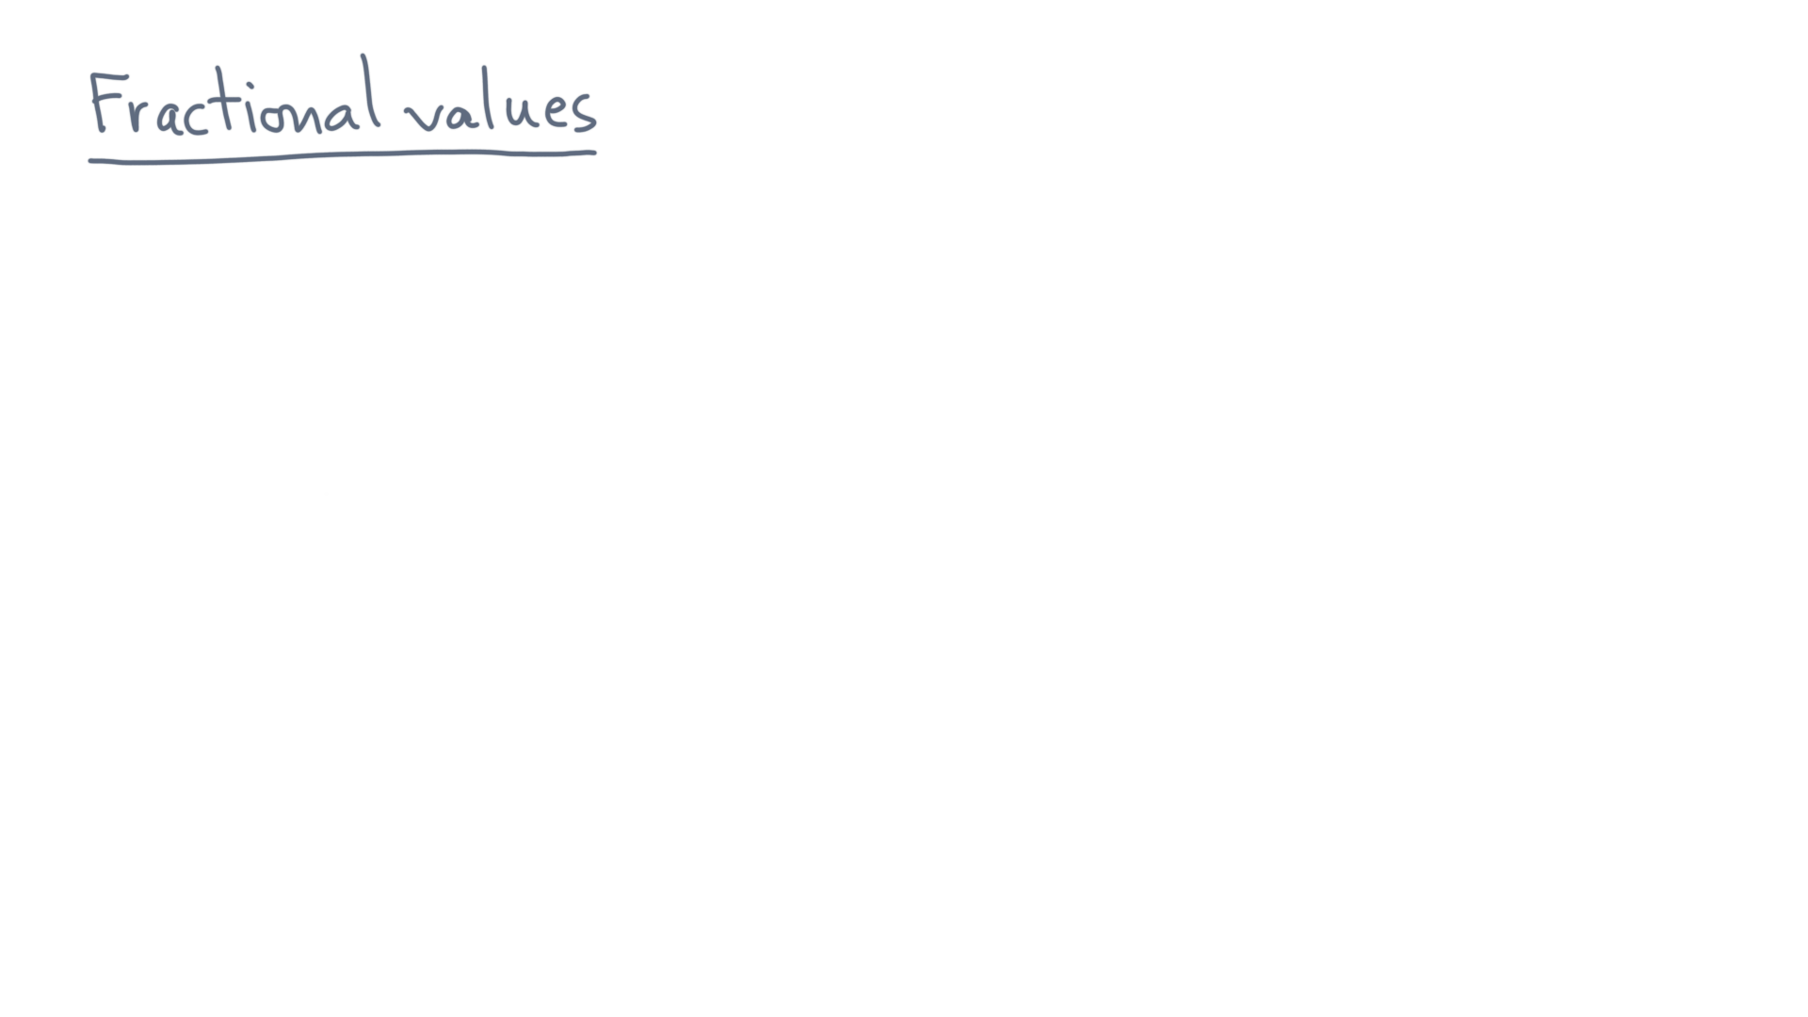
Notes:
Let’s start with a string of digits, as before, but this time with a *fractional* part.

Slide 3
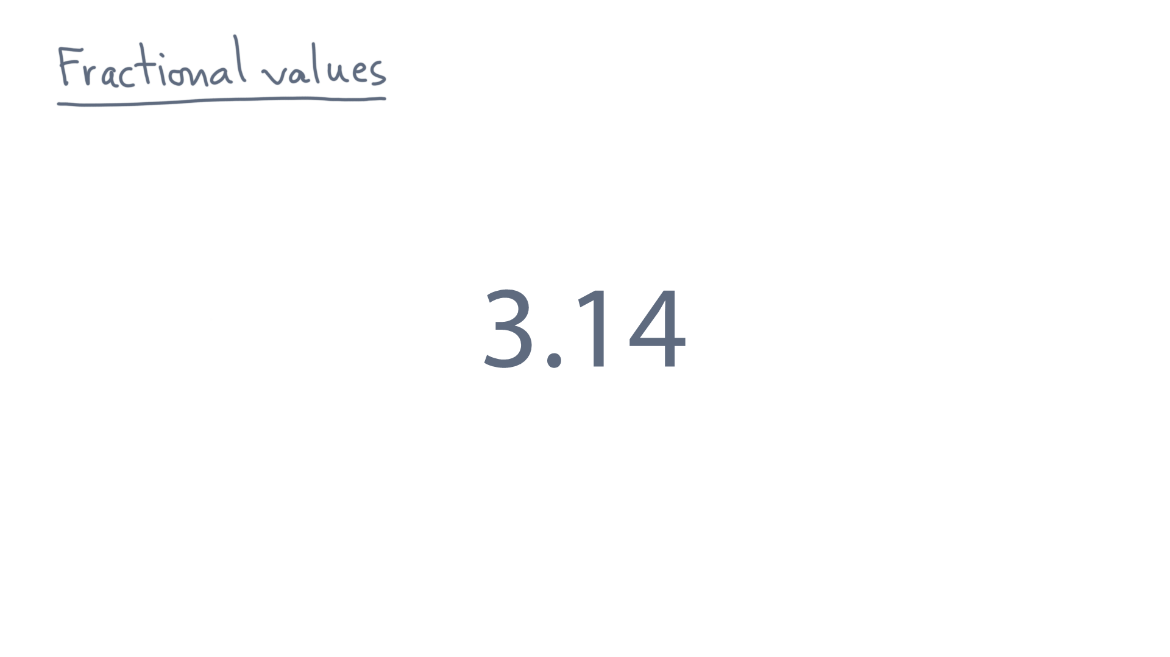
Notes:
And supposing it is a base-ten representation, let’s say we want its mathematical value.

Slide 4
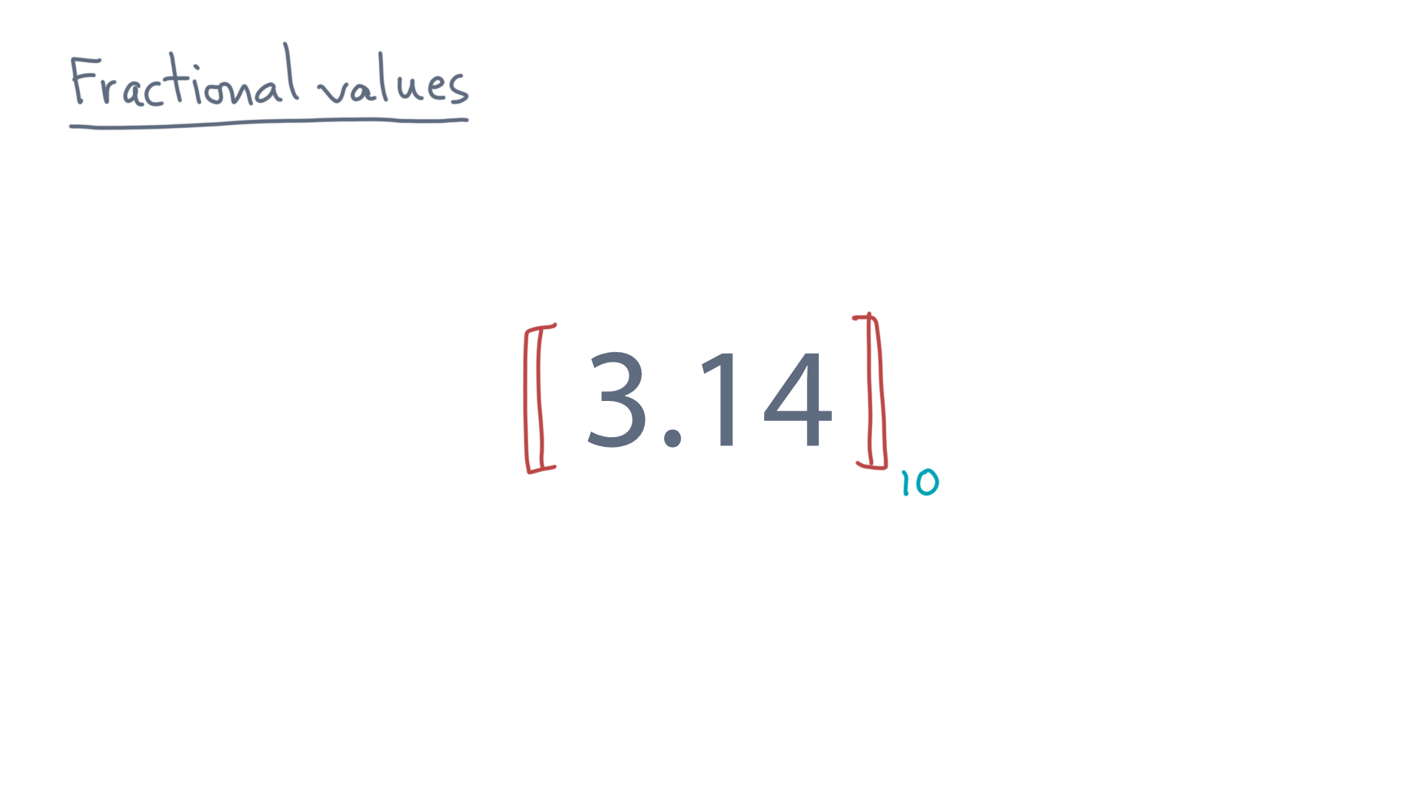
Notes:
As before, think of every digit as having a position in the string.

Slide 5
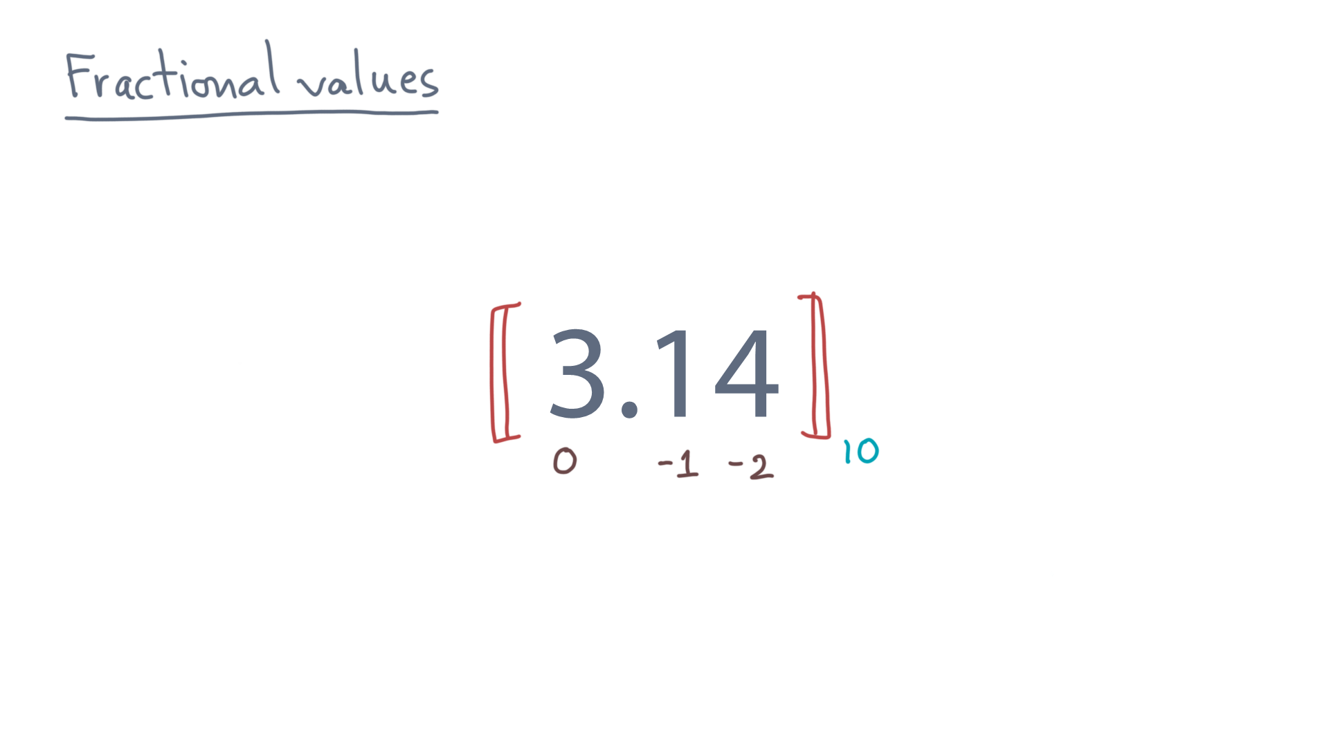
Notes:
Again, let’s adopt the same convention of numbering places so that they increase from right to left.
But now, let’s use *negative* integers to represent the positions to the right of the decimal point.

Slide 6
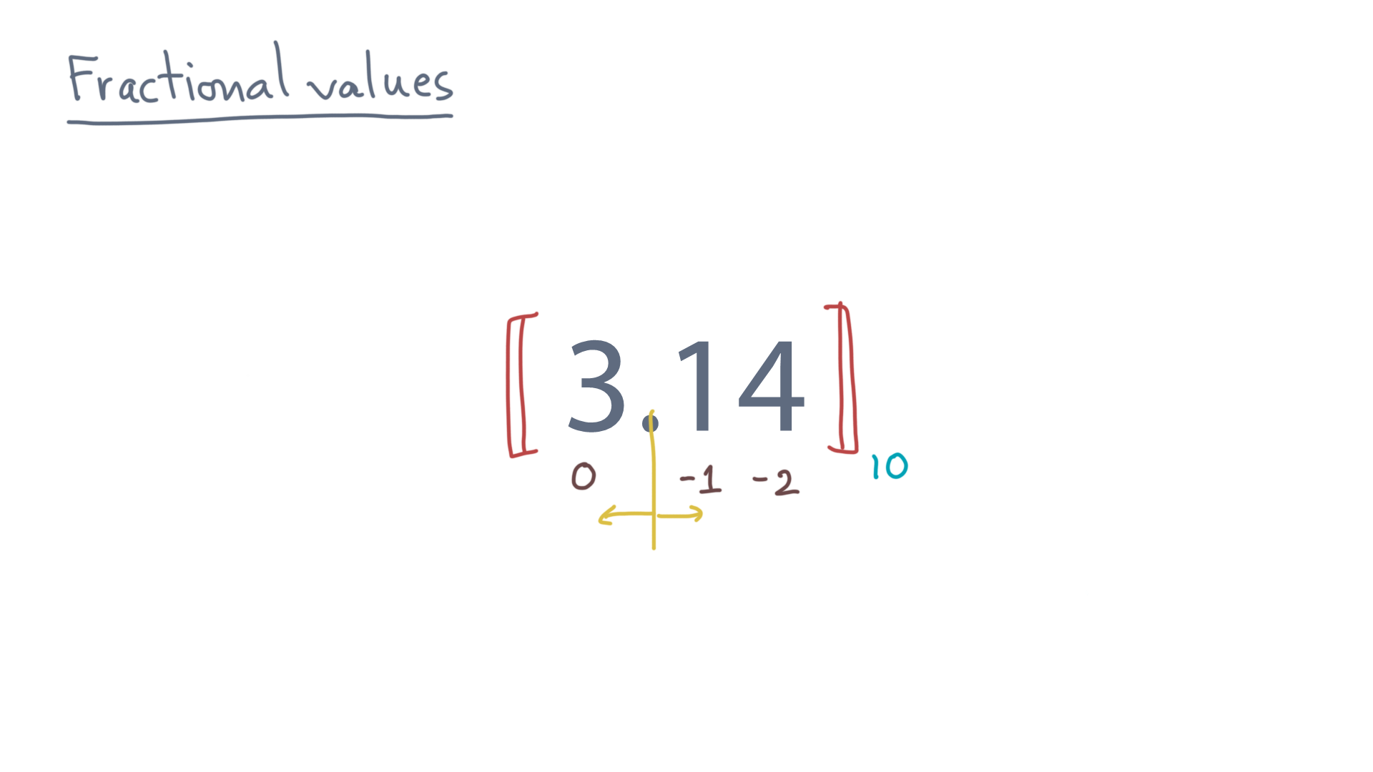
Notes:
This convention means you can compute the contribution of each digit in the same way you did before.

Slide 7
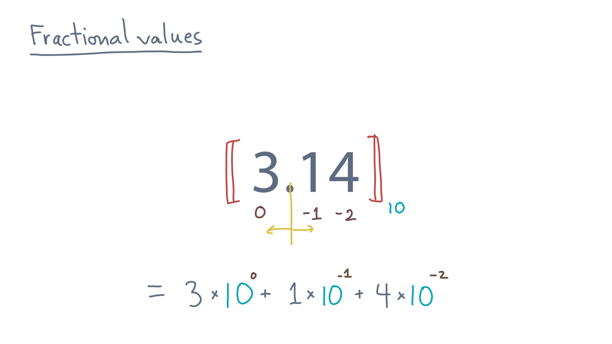
Notes:
Namely, multiplying the digit by the base raised to the position.
Again, it’s just a series.

Slide 8
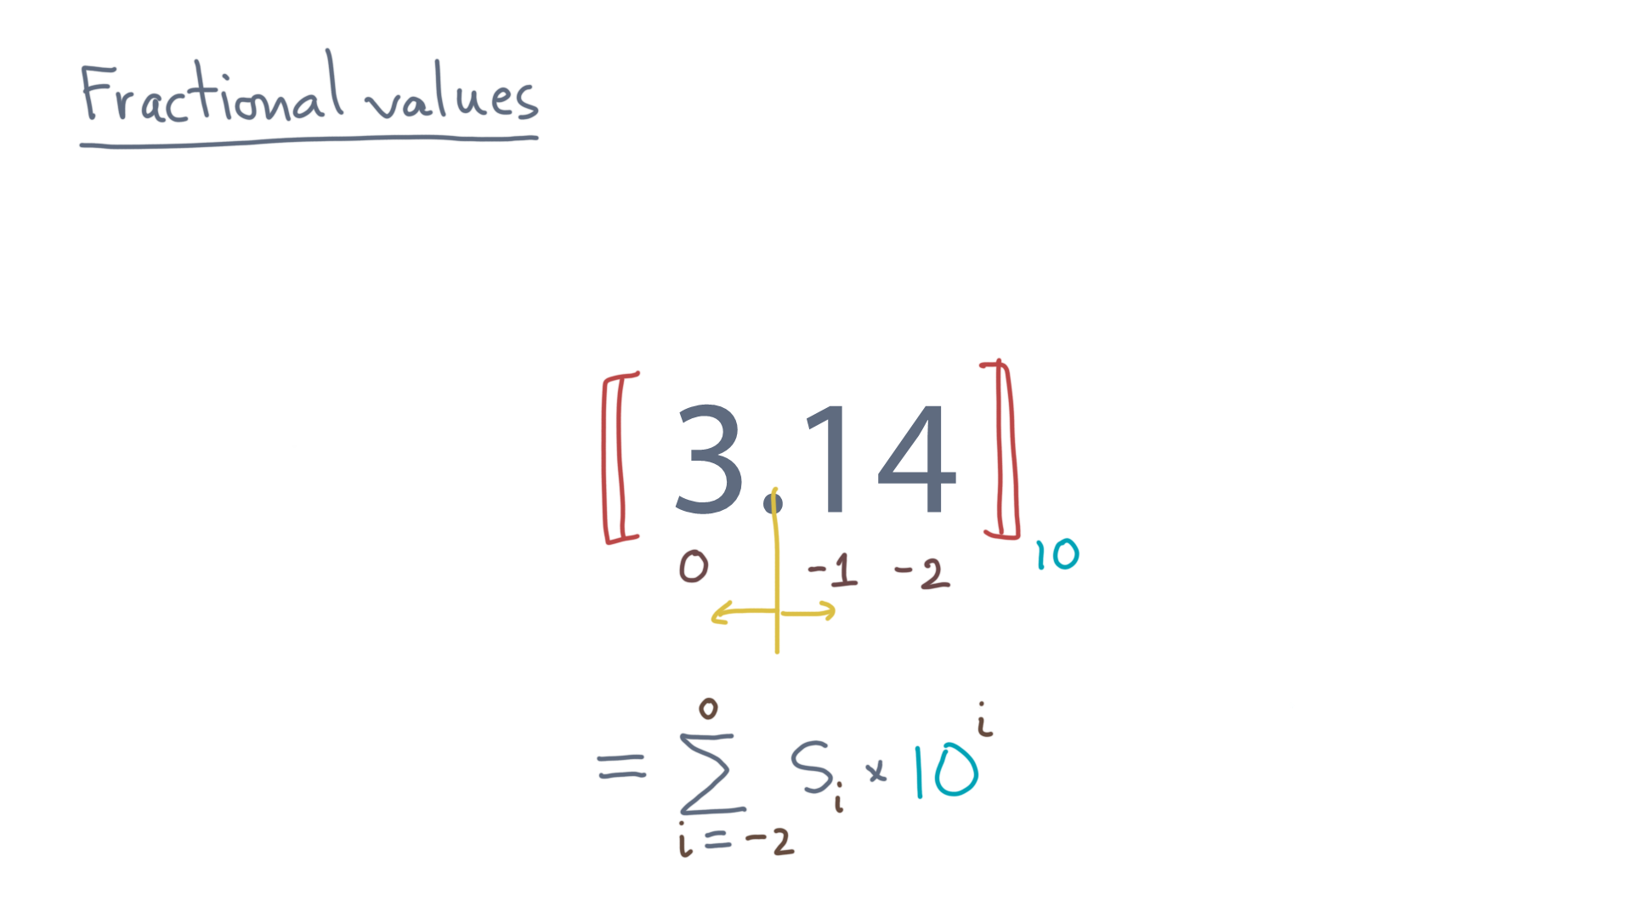
Notes:
But notice the indices.

Slide 9
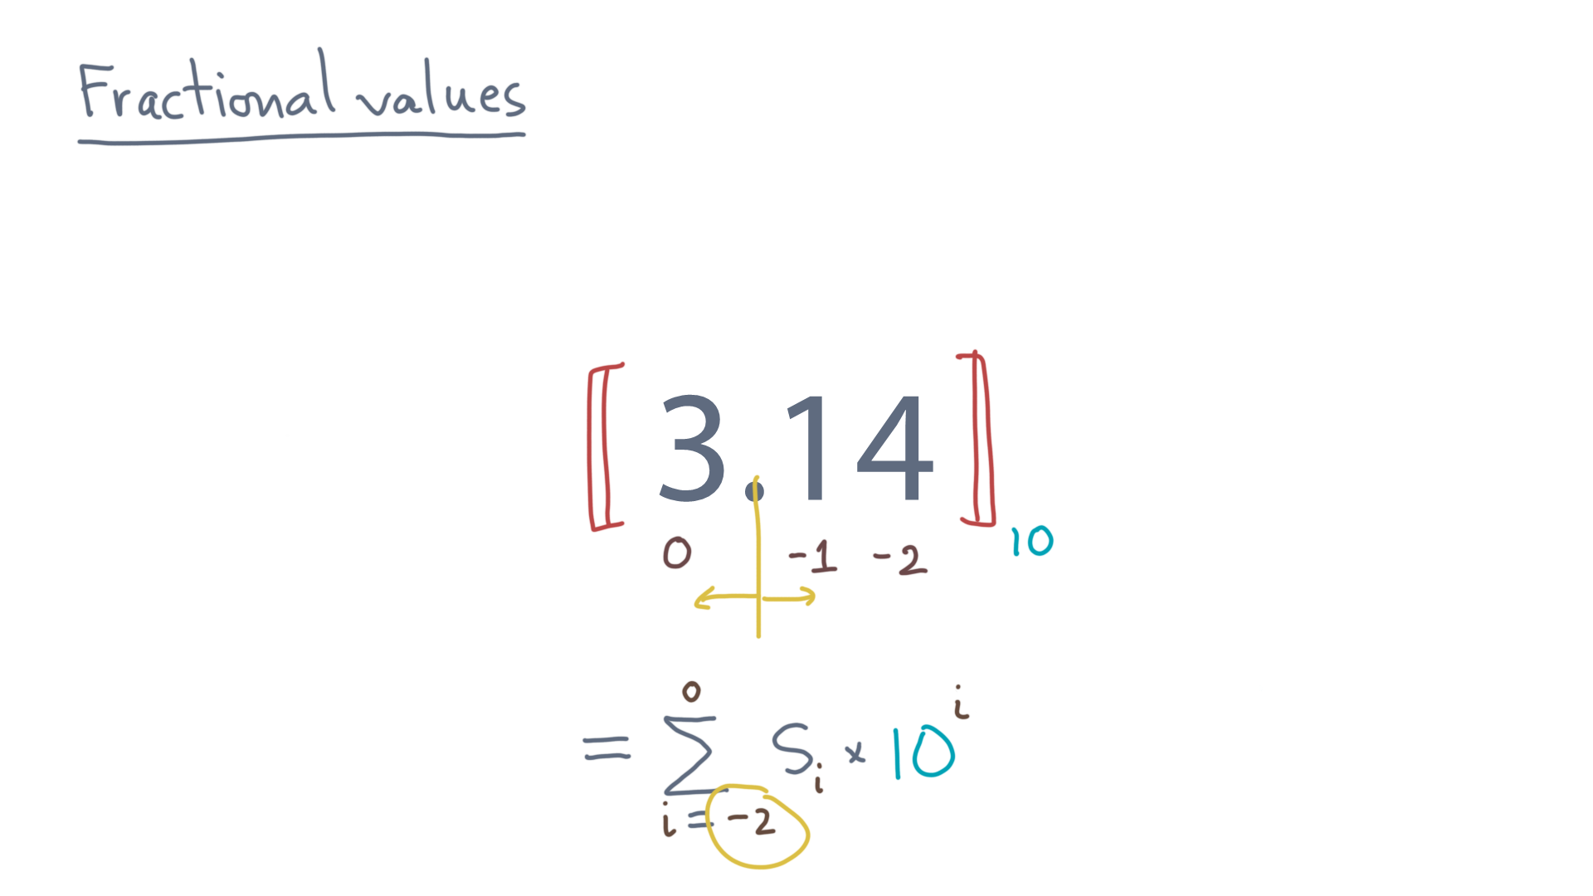
Notes:
They now might include negative position.

Slide 10
Notes:
Of course, the same idea applies to any base.

Slide 11
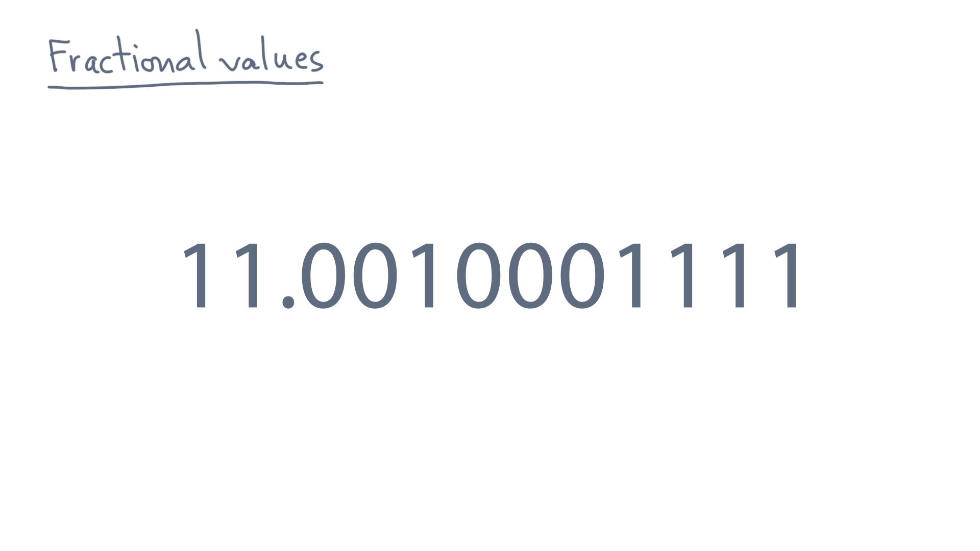
Notes:
Here is a binary example.

Slide 12
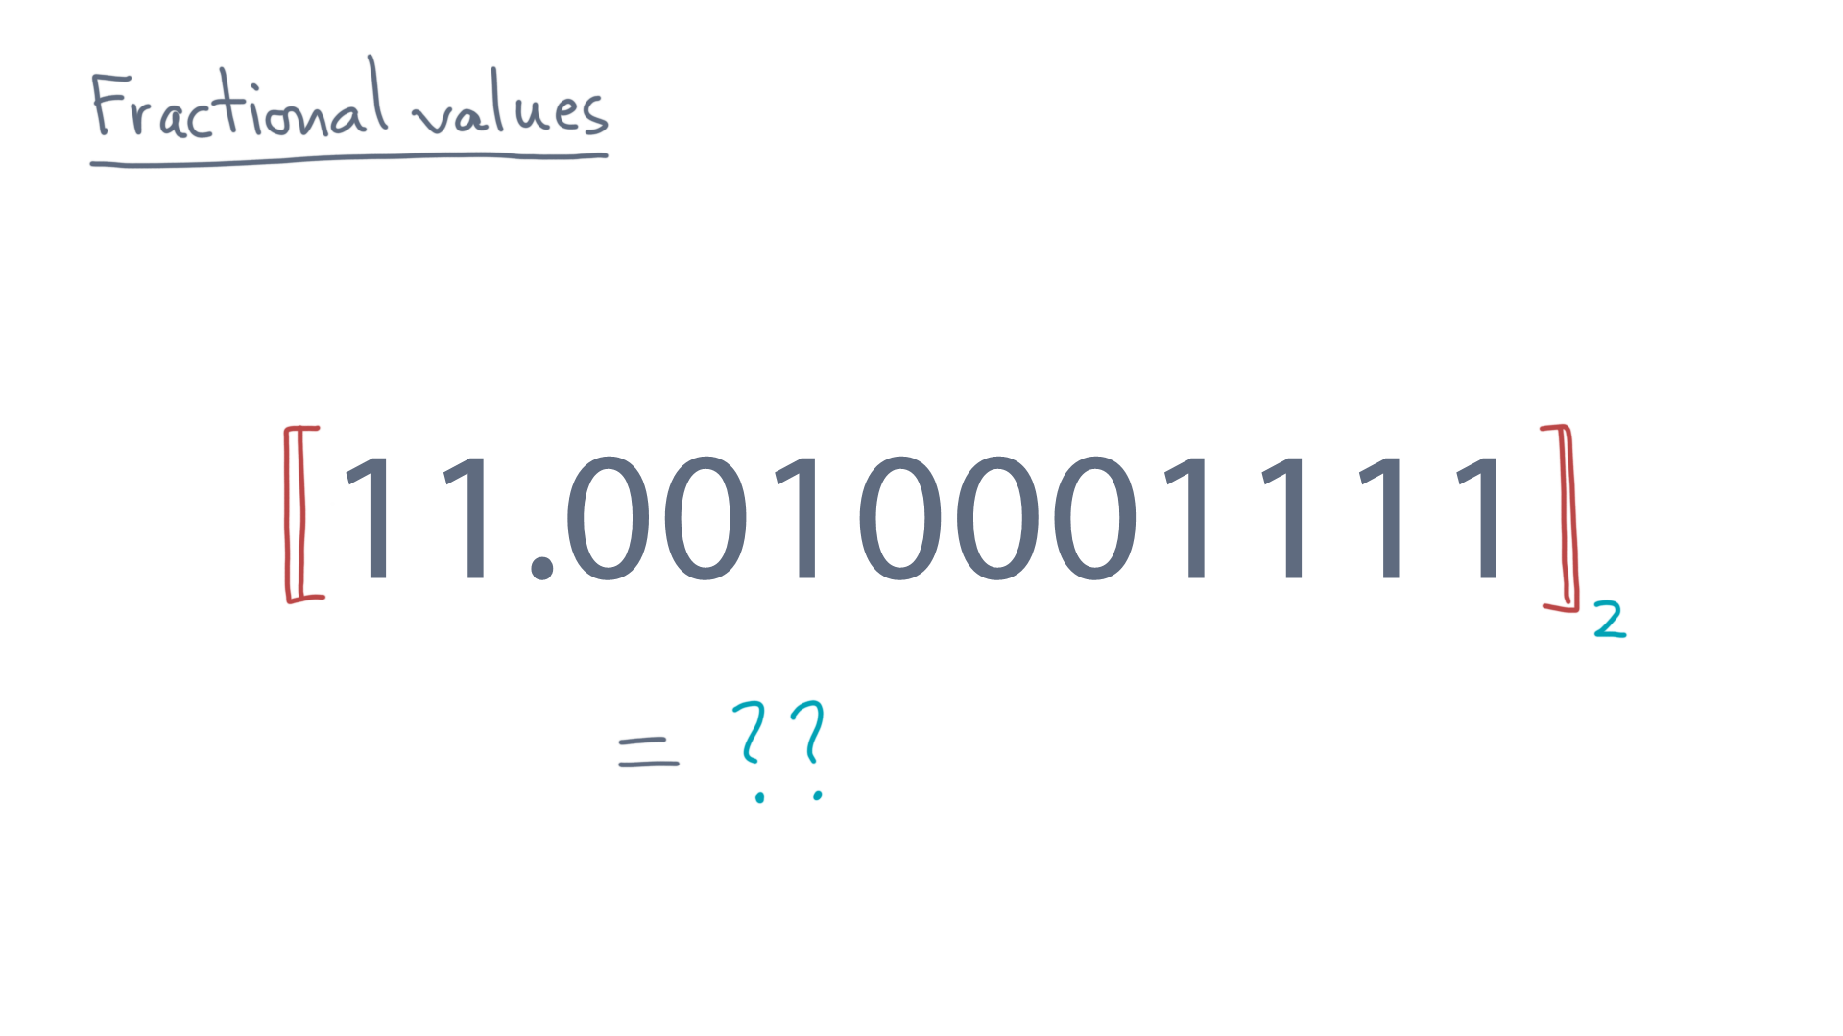
Notes:
As an exercise, you might pause and compute its numerical value.

Slide 13
Notes:
Now, in principle you don’t actually care about what base you use to represent a number.
It’s just notation.

Slide 14
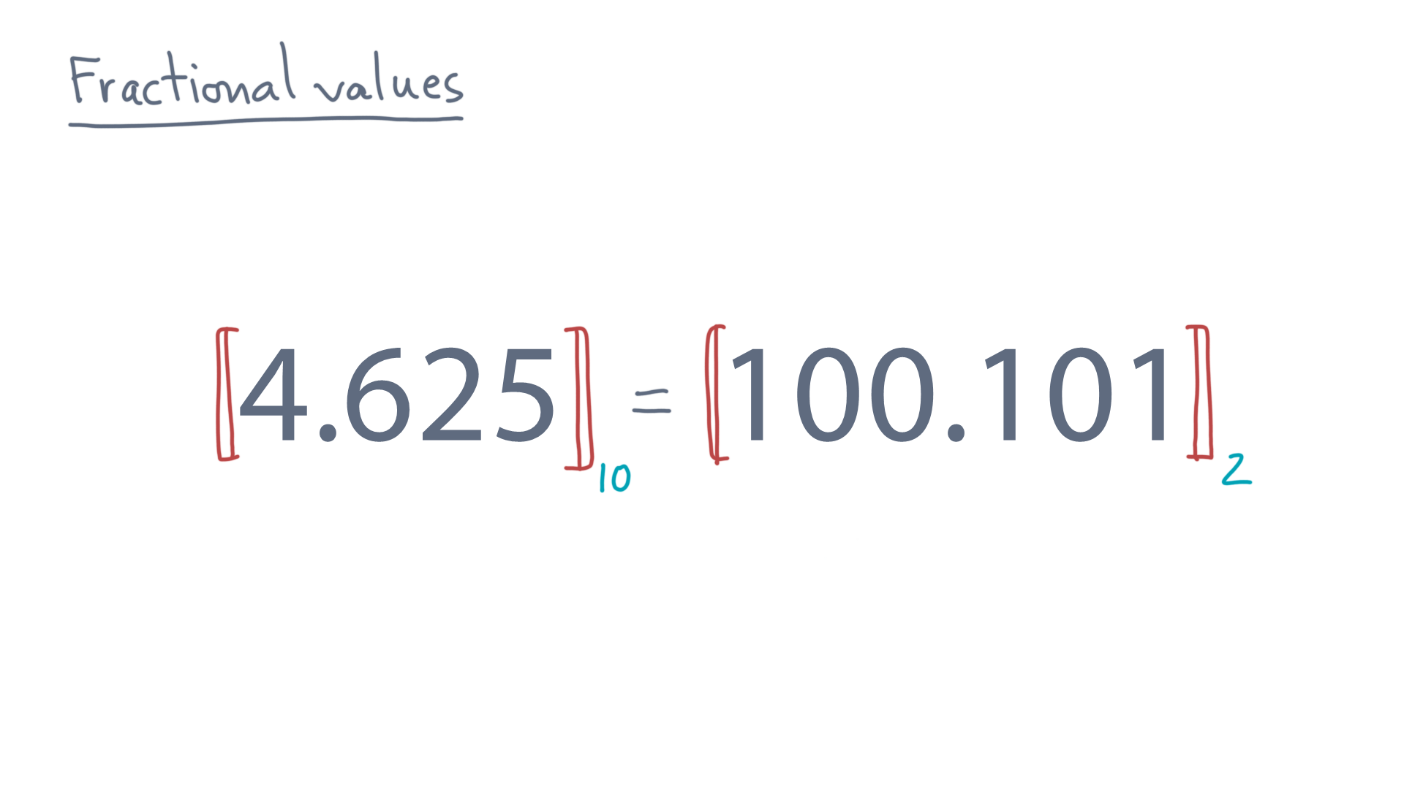
Notes:
For instance, 4.625 in base 10 is mathematically identical to 100.101 in base 2.
Again, you should pause and check my math.
But what about this base 10 value?

Slide 15
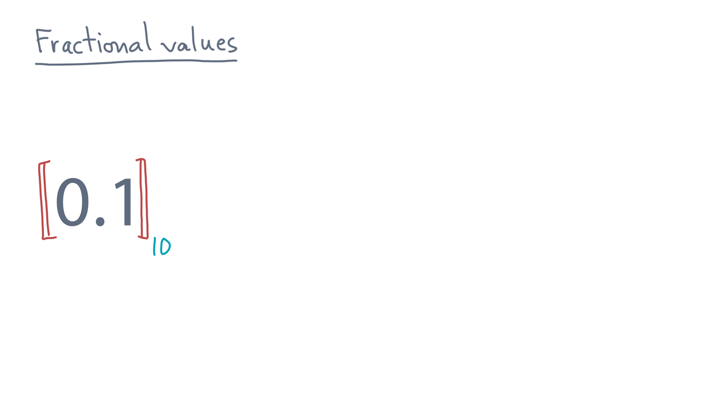
Notes:
What is its base 2 representation?

Slide 16
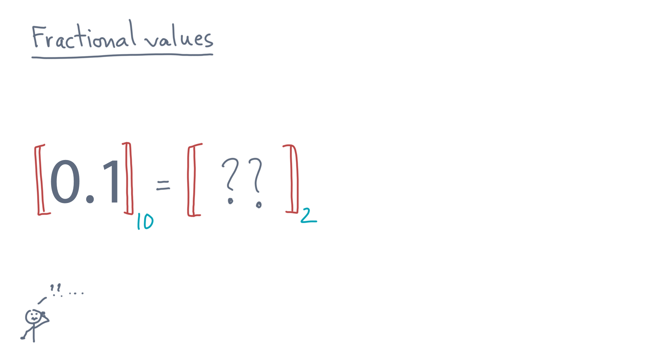
Notes:
Take a moment to try to calculate this yourself.
(PLAY JEOPARDY JINGLE?)

Slide 17
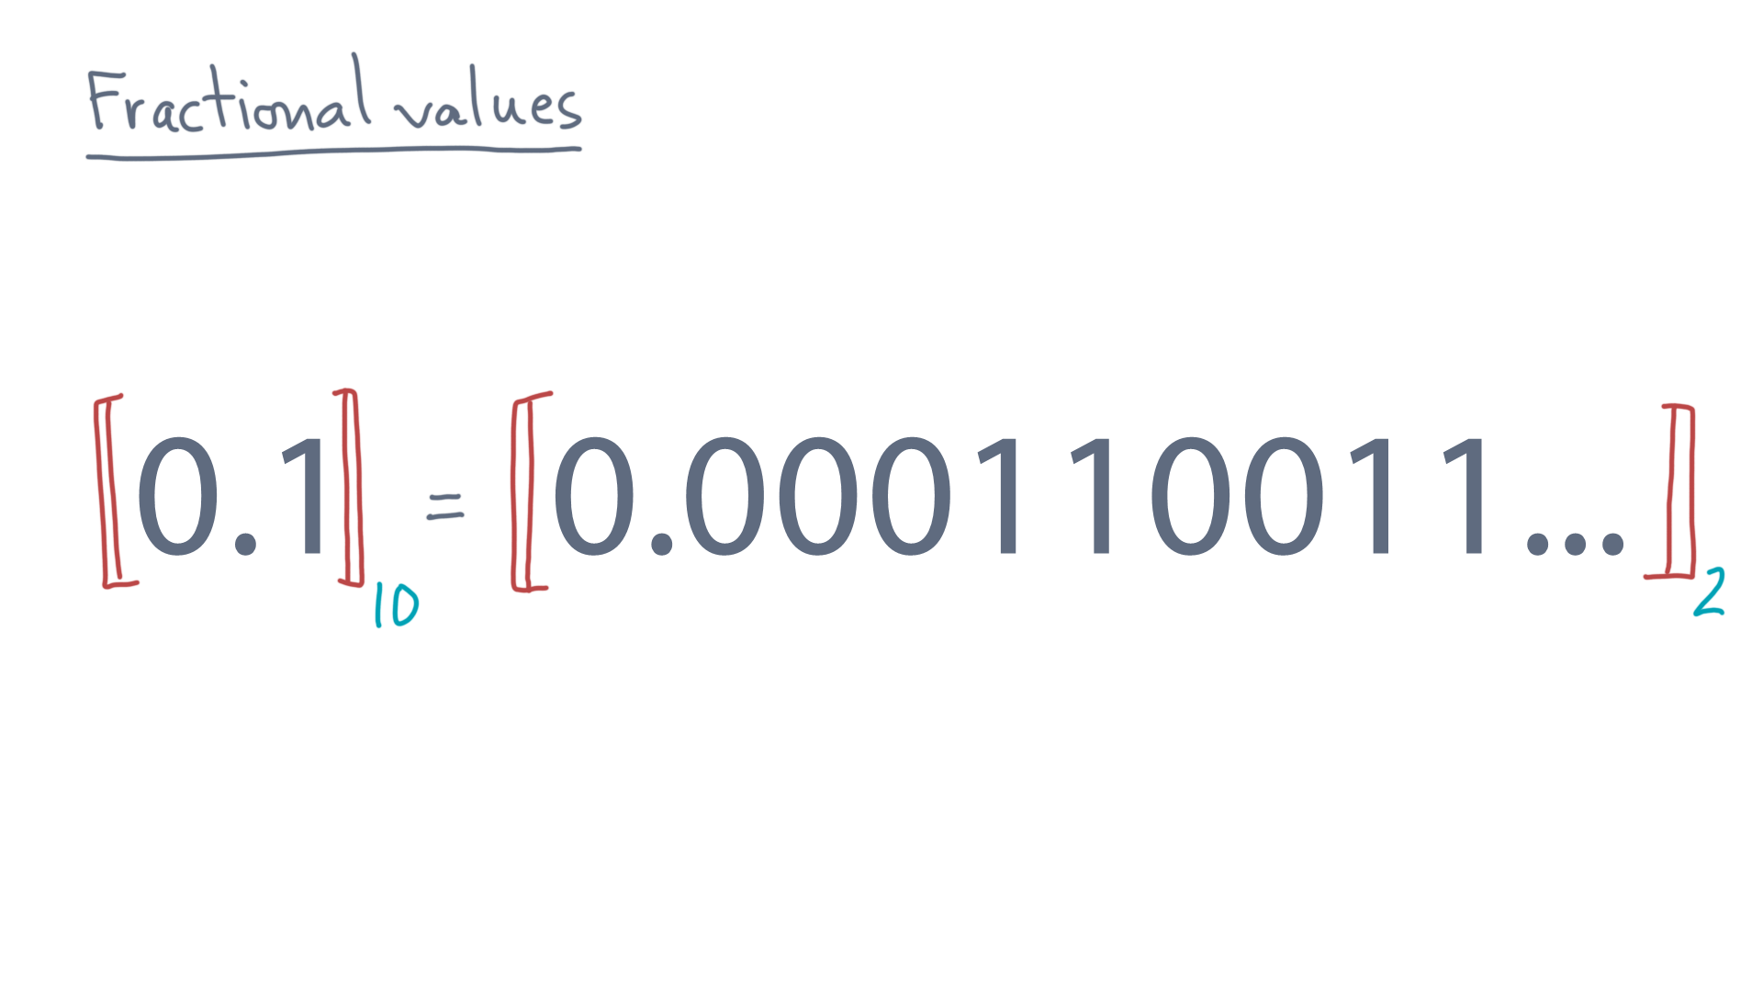
Notes:
This is the result, which may have been surprising.
The base two form is actually infinite!

Slide 18
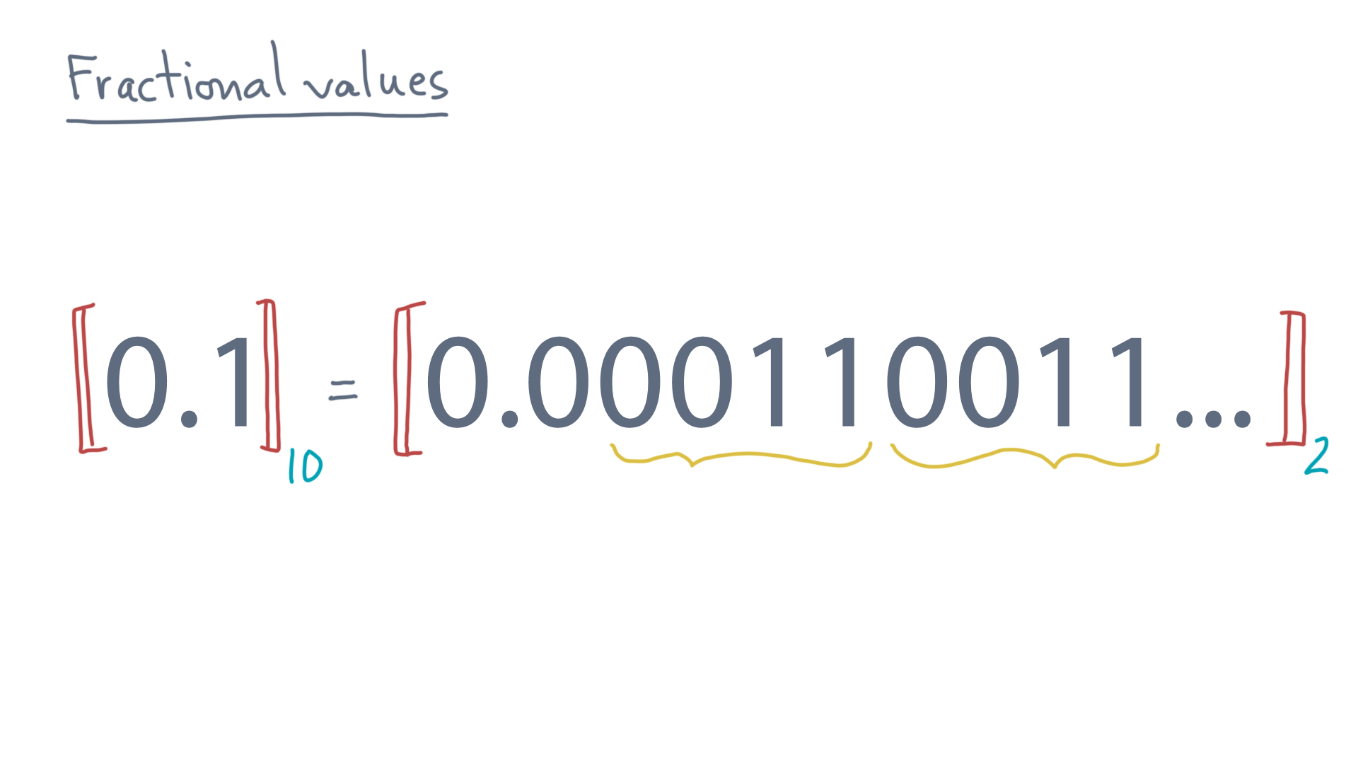
Notes:
After the first zero to the right of the decimal point, there is a subsequence, zero, zero, one, one, that repeats forever.

Slide 19
Notes:
So why is this fact important?
Here is the immediate consequence.

Slide 20
Notes:
Remember that most computer hardware stores and manipulates numbers in binary, not decimal.
So just because a decimal number, like 0.1, looks finite, it’s exact binary equivalent might be infinite.

Slide 21
Notes:
But most computers don’t have infinite storage.
So, even when you think you are storing an exact value, you might only have an approximation of it.

Slide 22
Notes:
Now for applications where you need exact values, there will be ways of trying to deal with that.
But as you can imagine, tracking exact values will come at a price, namely, the speed of computation.

Slide 23
Notes:
So, beyond that, you will have to live with approximation.
What we’ll want to do next is figure out just how to do that.

